Slide 1
Employee Data Analysis using Excel
STUDENT NAME: RESHMI NANDA R
REGISTER NO: OF253DB25CB7A49A3B644EF9CC8551CA
DEPARTMENT: COMMERCE
COLLEGE: MEENAKSHI COLLEGE FOR WOMENS

Slide 2
PROJECT TITLE
“OPTIMIZING RESOURCE ALLOCATION AND UTILIZATION ACROSS DEPARTMENTS”

Slide 3


AGENDA
Problem Statement
Project Overview
End Users
Our Solution and Proposition
Dataset Description
Modelling Approach
Results and Discussion
Conclusion
3/21/2024 Annual Review

Slide 4

PROBLEM STATEMENT
Analyse the distribution of full time equivalents across various departments
To identify any imbalances or areas of concern. Specifically evaluate whether the allocation of FTEs aligns with departmental needs, overall workload, organisational objectives. Determine of amu departments are under or over staffed, and purpose recommendations for optimizing staffing levels to improve efficiency and balance across the organisation. This problem statement aims to assess the current staffing situation and identify opportunities for better alignment and efficiency.

Slide 5

PROJECT OVERVIEW
The project aims to evaluate and optimize the allocation of fulltime equivalents across various departments within the organisation. The goal is to ensure that staffing levels are aligned with departmental needs, organisational goals, and overall workload. Its scope is to analyse the current FTE distribution across departments and compare the allocations against departmental objectives and workload requirements. Determine if any departments are under staffed. Assess the impact of current staffing levels on departmental performance and organizational efficiency. Propose adjustments to FTE allocations to address identified imbalances. Suggest strategies for better alignment of staffing levels with departmental needs.

Slide 6

WHO ARE THE END USERS?
The end users of the project to optimize FTE distribution are department heads /managers , HR department , senior managements and executives. They will directly benefit from a more balanced and effective staffing allocation, which can improve departmental operations and performance. HR will use the recommendations to make informed decisions about staffing, recruitment, and resource allocations. They will rely on the optimized FTE distribution to ensure the organization's overall efficiency, strategic alignment, and achievement of business goals. The project may affect employees as hangs in staffing levels could their workloads, roles, and humifactions.

Slide 7

OUR SOLUTION AND ITS VALUE PROPOSITION
The solution involves conducting a comprehensive analysis of the current Full-Time Equivalent (FTE) distribution across departments, identifying imbalances, and recommending adjustments to optimize staffing levels. The solution involves conducting a comprehensive analysis of the current Full-Time Equivalent (FTE) distribution across departments, identifying imbalances, and recommending adjustments to optimize staffing levels. Evaluate current FTE allocation against departmental workload and objectives. Use historical performance and workload data to assess staffing needs. Pinpoint departments with over-staffing or under-staffing issues.

Slide 8
Dataset Description
In our solution, the data set will be leveraged as follows: Review Current Allocations Analyze the FTE distribution across departments to understand how staffing is currently allocated. Use the data to spot patterns, such as departments with disproportionately high or low staffing levels. Compare the current FTE allocations with the actual workload and requirements of each department. Assess how current staffing levels affect departmental performance . Based on the analysis, recommend changes to better align staffing levels with departmental needs and strategic objectives. Suggest reallocation of FTEs to address under-staffing or over-staffing issues.

Slide 9

THE "WOW" IN OUR SOLUTION
our solution offers a transformative approach to workforce management by providing a detailed analysis of Full-Time Equivalent (FTE) distribution across departments, segmented by
gender. This detailed breakdown unveils critical insights into gender balance within the organization, highlighting areas where disparities exist. The real "wow" factor lies in our ability to integrate this data into actionable recommendations that align with broader diversity and inclusion goals. Our solution not only supports compliance with these goals but also enhances employee satisfaction and organizational fairness. By optimizing staffing decisions based on gender distribution, departments can boost performance and operational efficiency.
3/21/2024 Annual Review
9

Slide 10
MODELLING
Modeling Approach for Optimizing FTE Distribution: Ensure the data is accurate and free from errors or inconsistencies. Structure the data for analysis, ensuring each FTE allocation is correctly categorized by department and employee. Calculate basic statistics (mean, median, variance) for FTE allocations across departments. Use charts and graphs to visualize FTE distribution and identify patterns or outliers (e.g., histograms, bar charts). Compare FTE allocations with workload data, if available, to assess whether departments are over- or under-staffed. Evaluate departmental performance metrics to see how staffing levels impact output and efficiency. Regression Analysis: Use regression models to predict optimal FTE levels based on workload and performance data. Model different staffing scenarios to forecast the impact of various FTE adjustments.
10

Slide 11
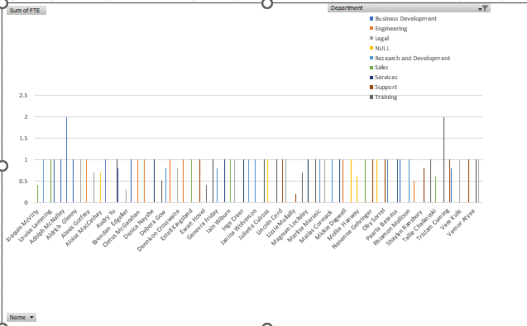
RESULTS
11

Slide 12
conclusion
The optimization of Full-Time Equivalent (FTE) distribution across departments is essential for enhancing organizational efficiency and aligning staffing levels with departmental needs and strategic goals. Our approach involves a comprehensive analysis of current FTE allocations, identifying staffing imbalances, and developing data-driven recommendations to optimize resource distribution. Key Findings: The initial analysis reveals areas where departments are either over-staffed or under-staffed, impacting overall performance and efficiency.

